Slide 1
Camera animation and uv mapping in blender
Anna witwicka

Slide 2
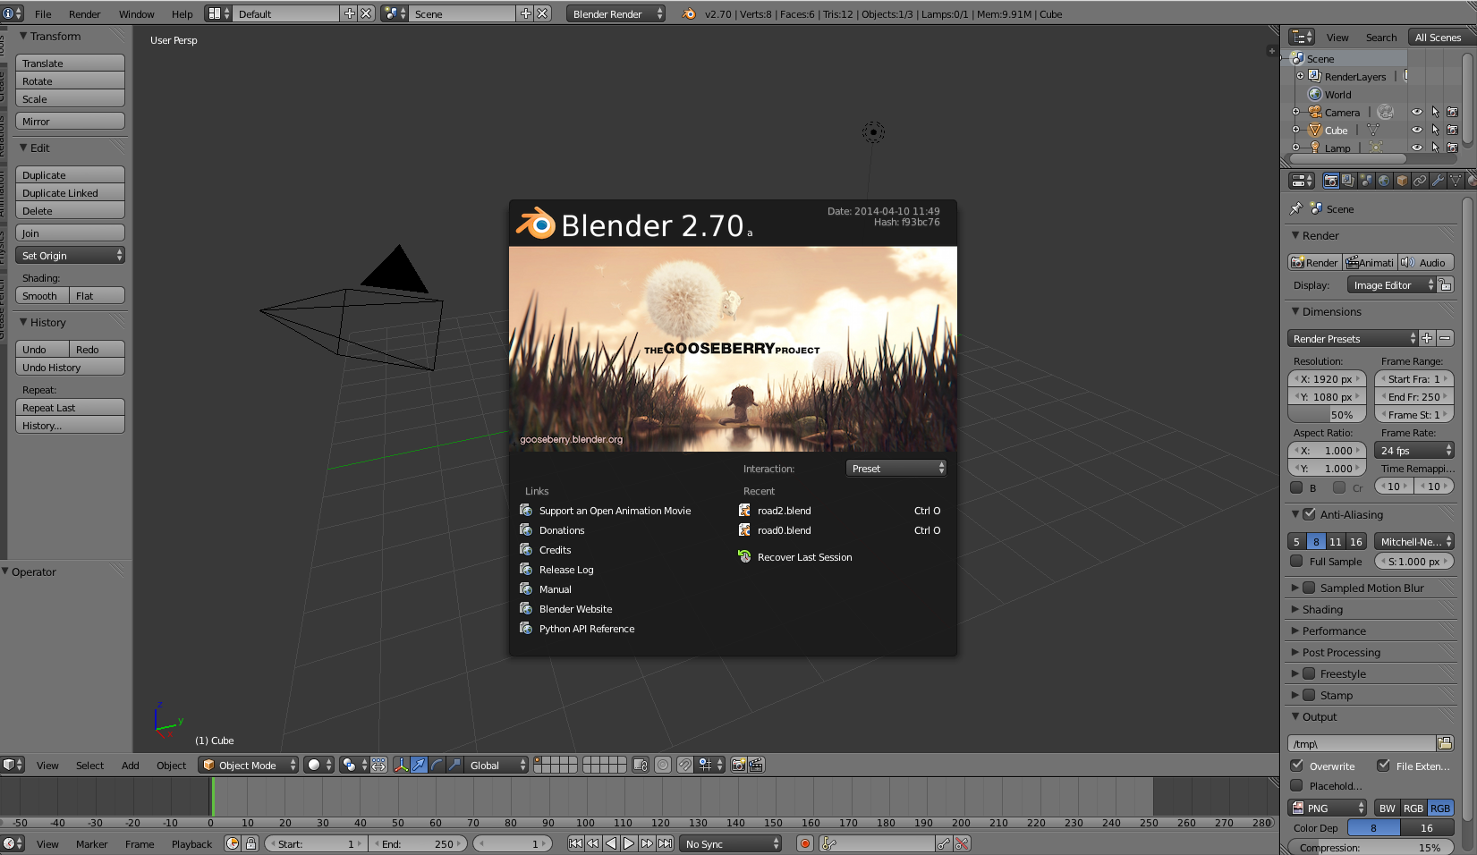
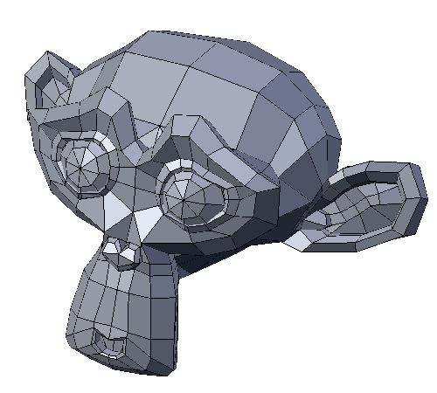
blender

Slide 3
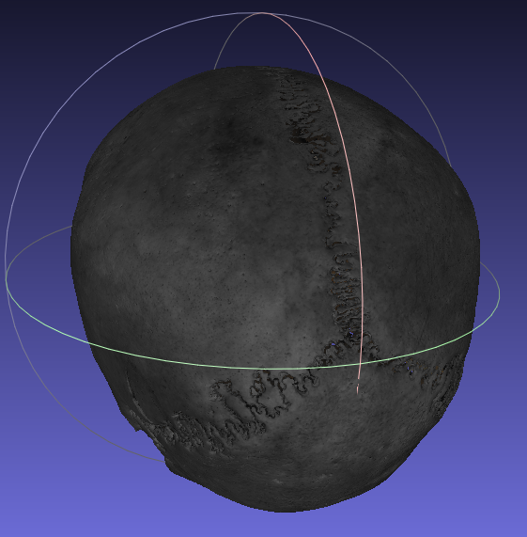
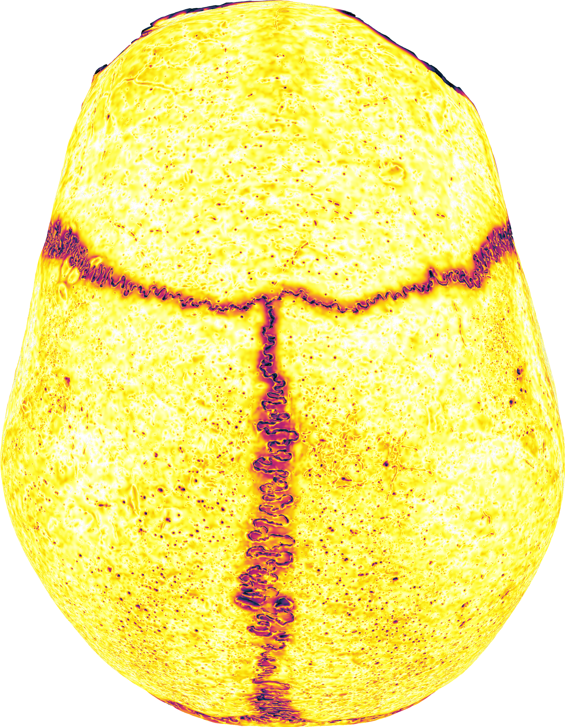
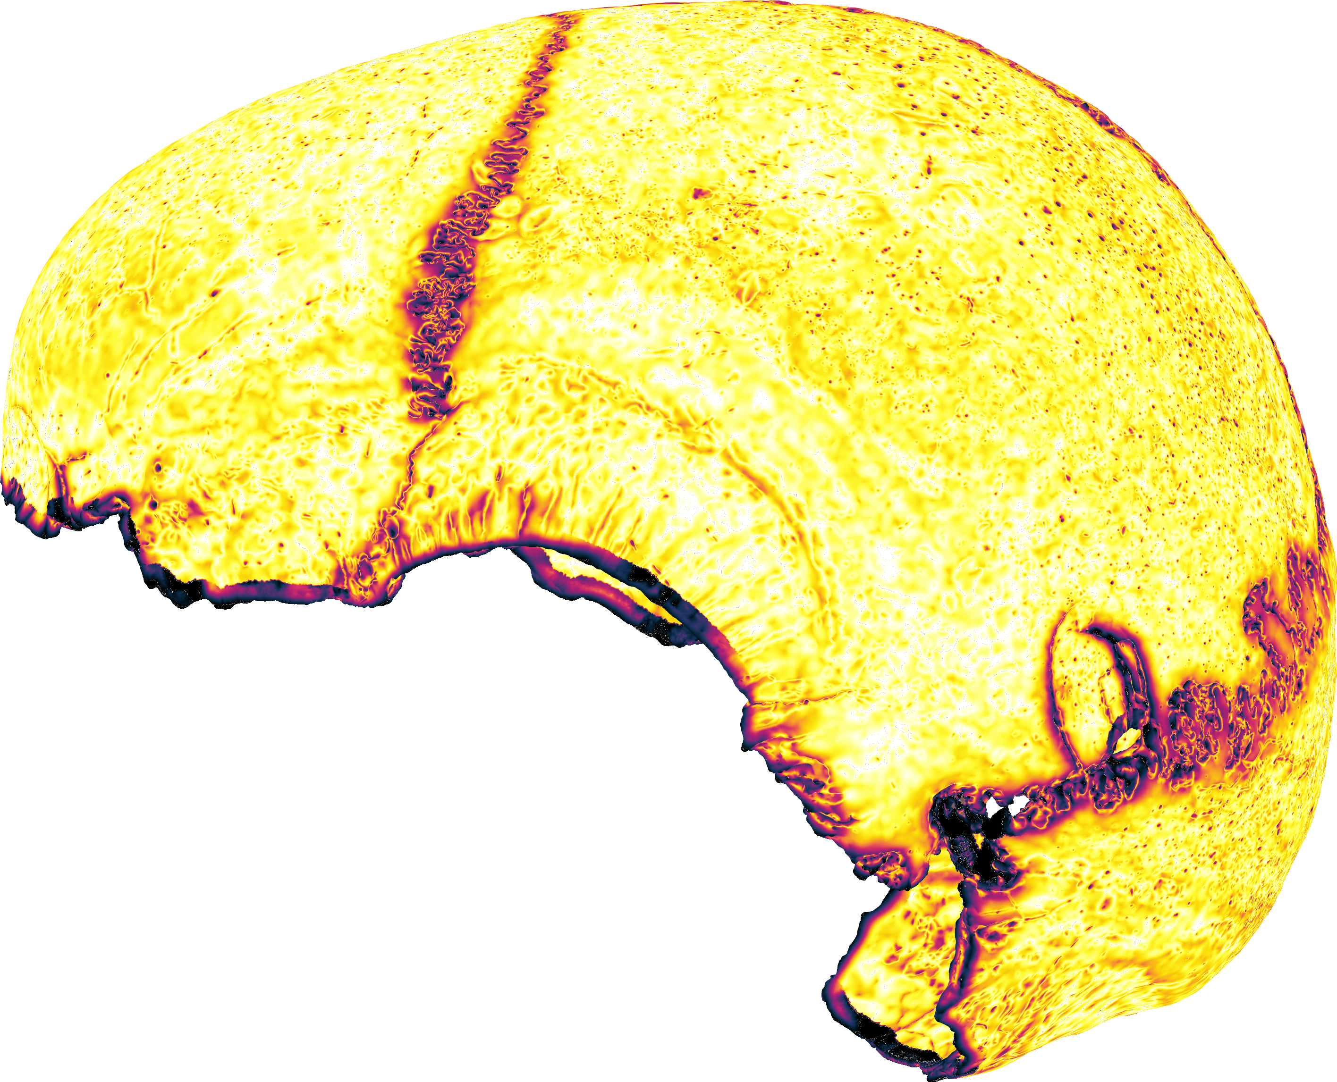
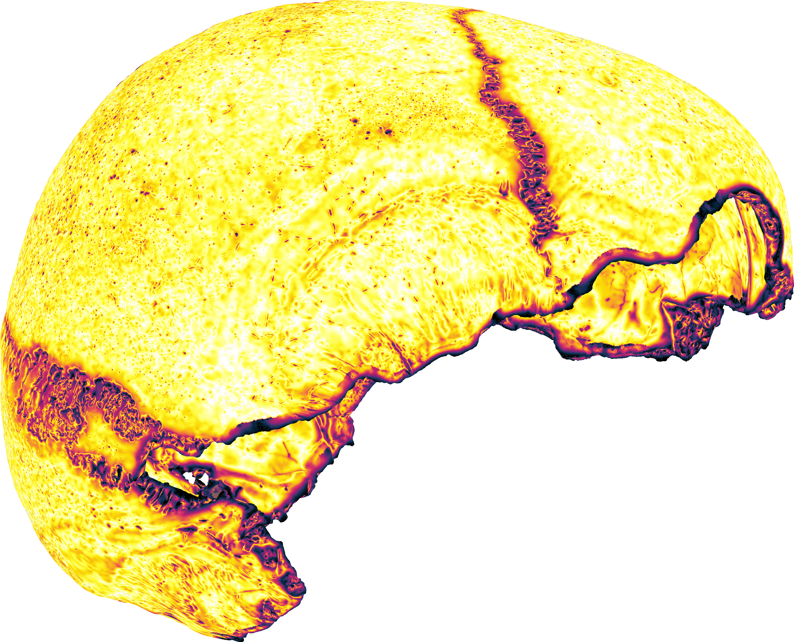
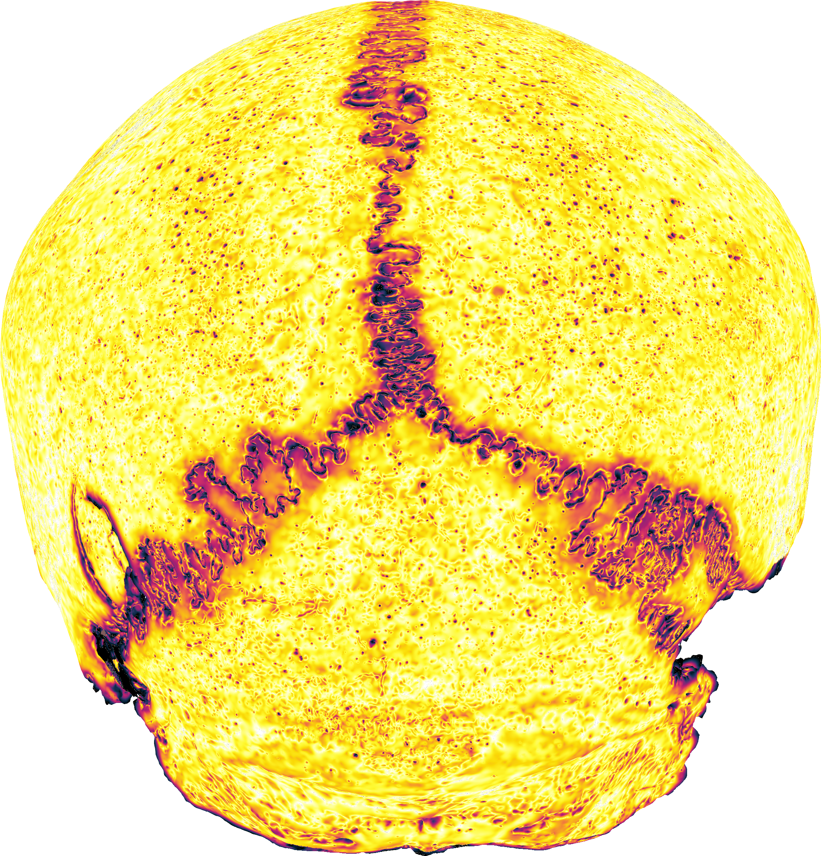
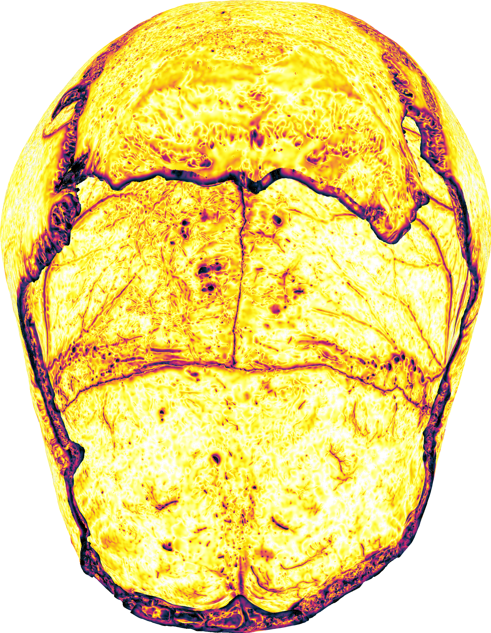
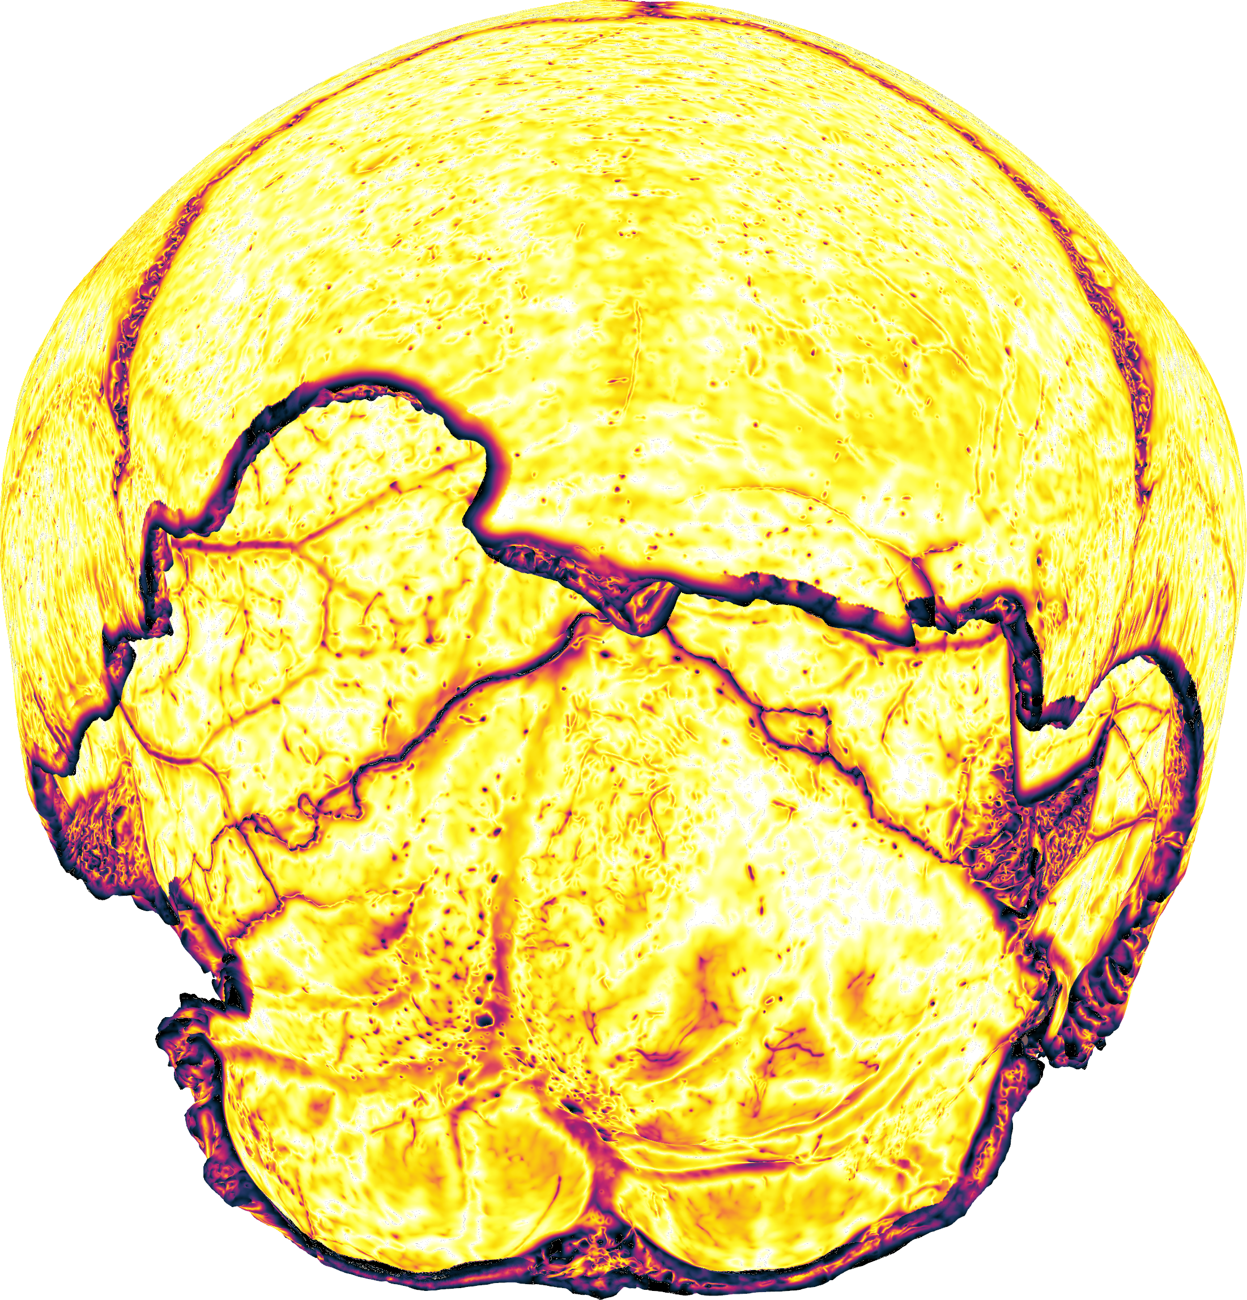
What i got
3D model of a skull (found in an archaeological excavation near Speyer)
Screenshots of a colored skull from sides (gigamesh)

Slide 4
Task: Illustrative film of a textured skull
Reduce mesh to reasonable size
uv-textture mapping
Camera path
Infinite loop of a film

Slide 5
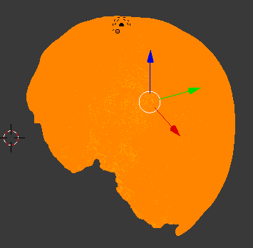
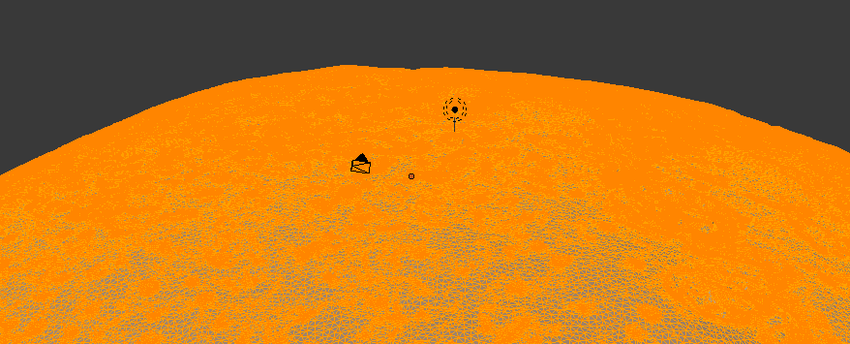
OBJECTIVES
Too many vertices
Texture mapping
How to move camera

Slide 6
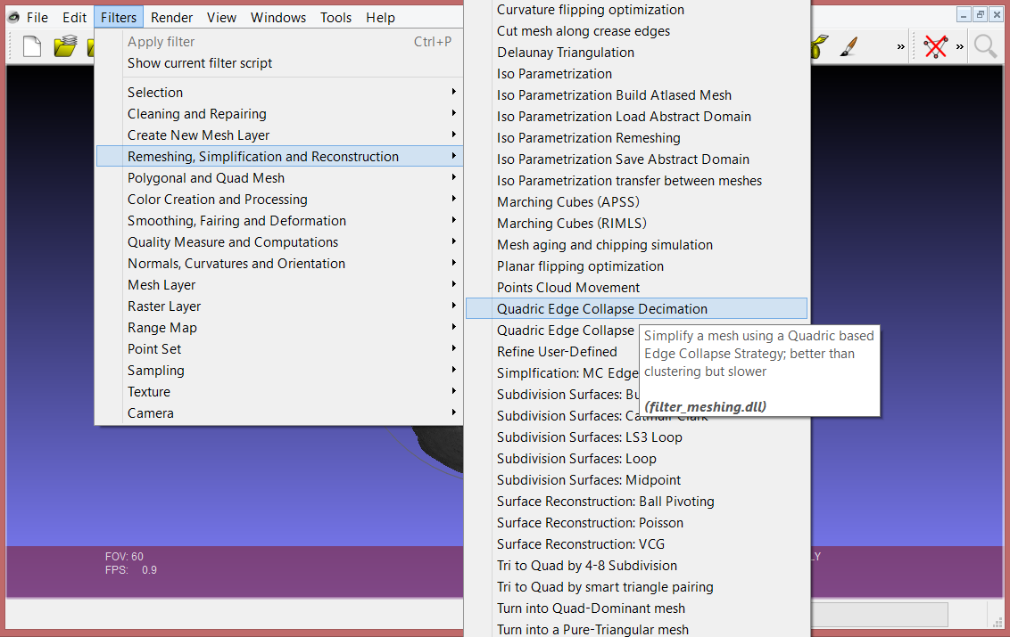
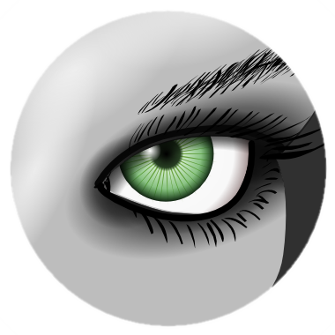
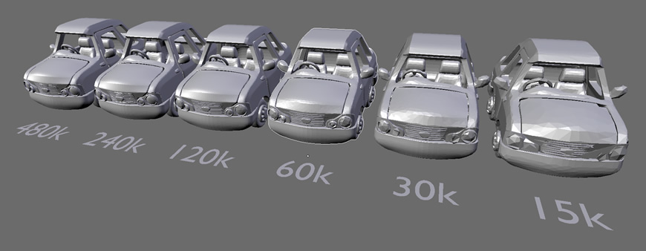
vertices
Meshlab – polygon reduction
http://www.shapeways.com/tutorials/polygon_reduction_with_meshlab

Slide 7
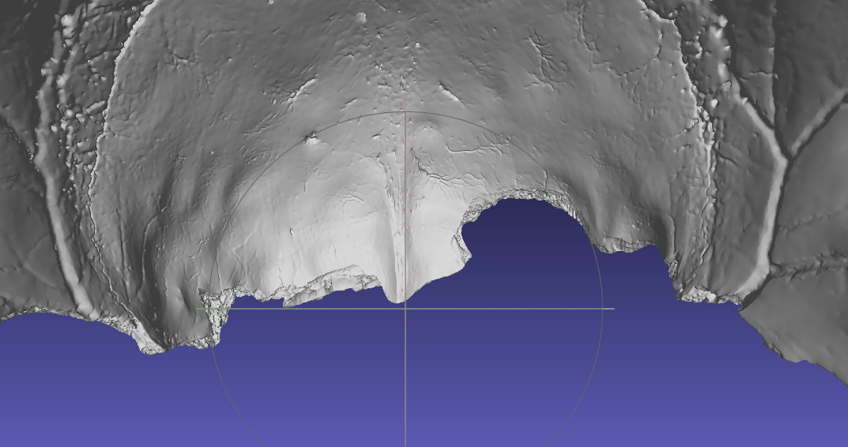
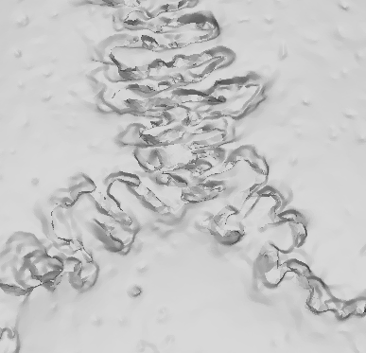
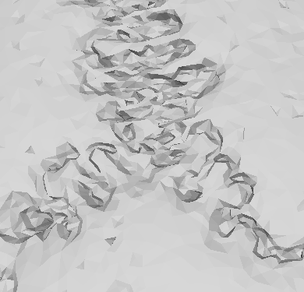
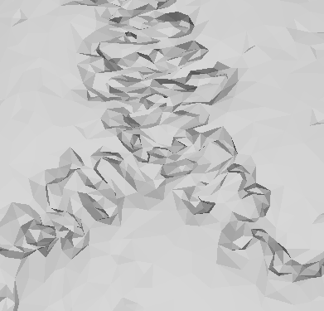
Reduction of number of faces
10 mill
0.25 mill
0.13 mill

Slide 8
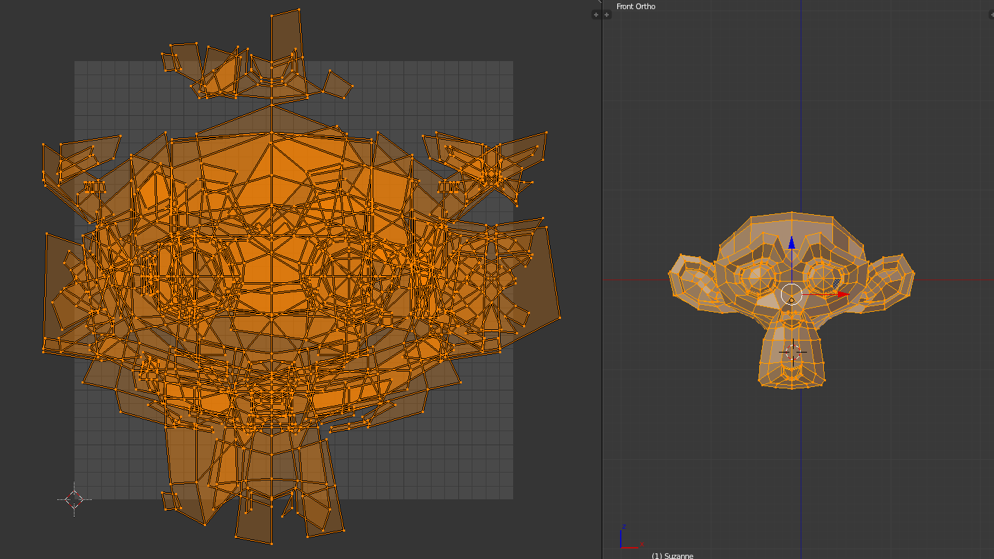
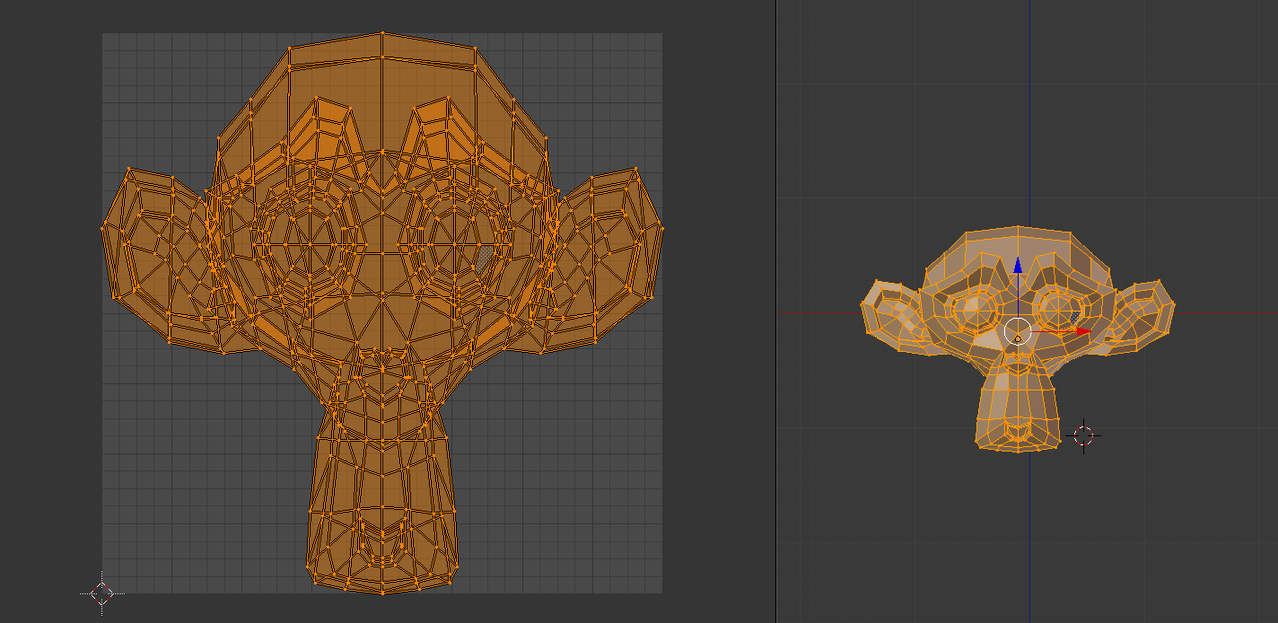
TEXTURE MAPPING
Cube projection
apply 6 textures to 6 sides
Project from View (Bounds)
Blender uv texturing
Notes:
2 problemy z preoject from bounds

Slide 9
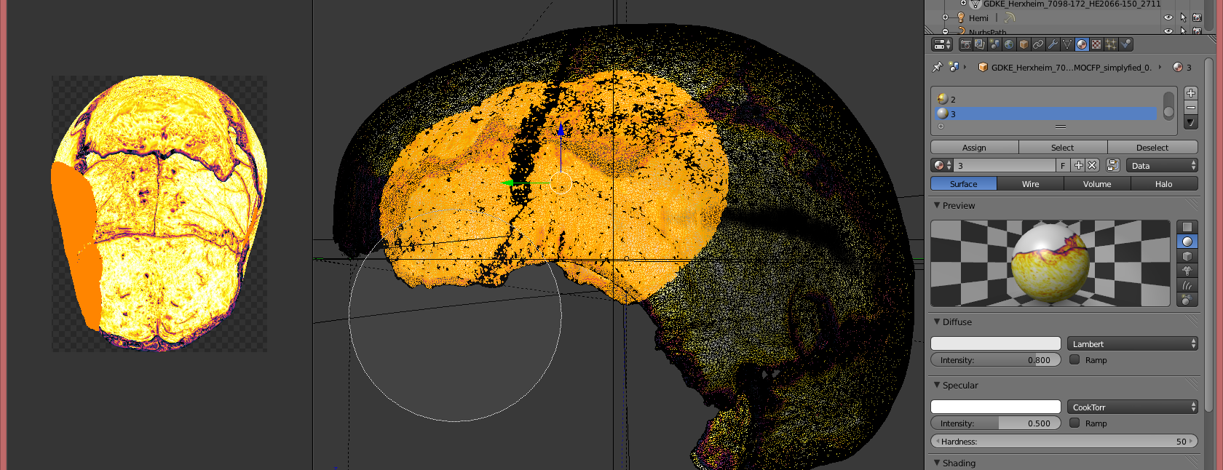
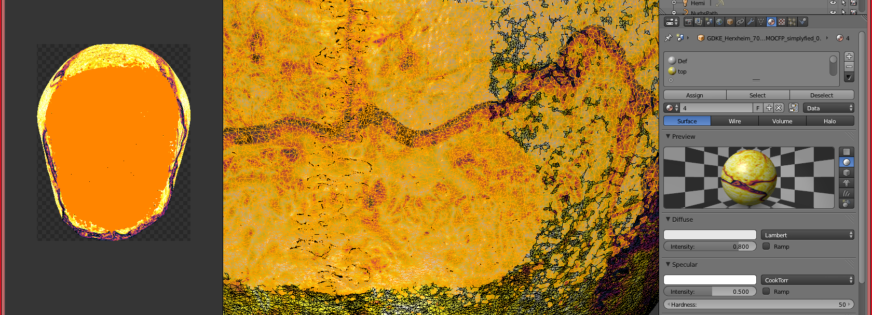
Notes:
Nie ma info o wszystkich miejscach textury

Slide 10
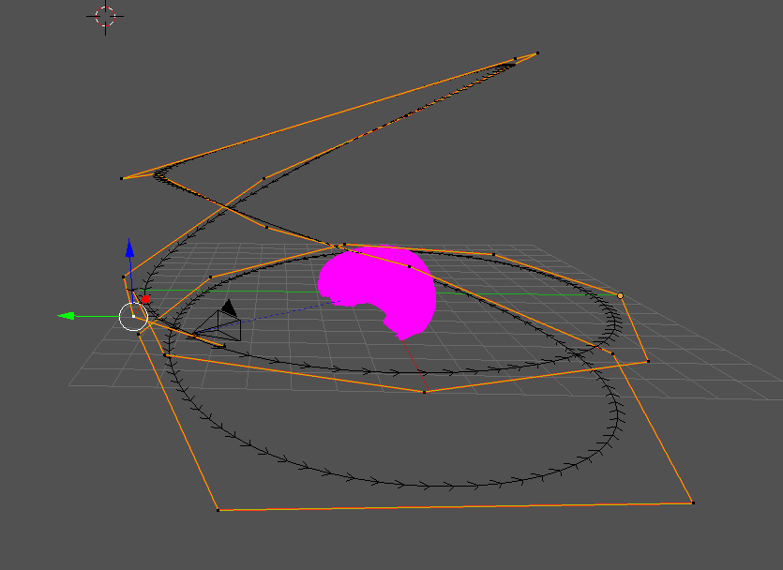
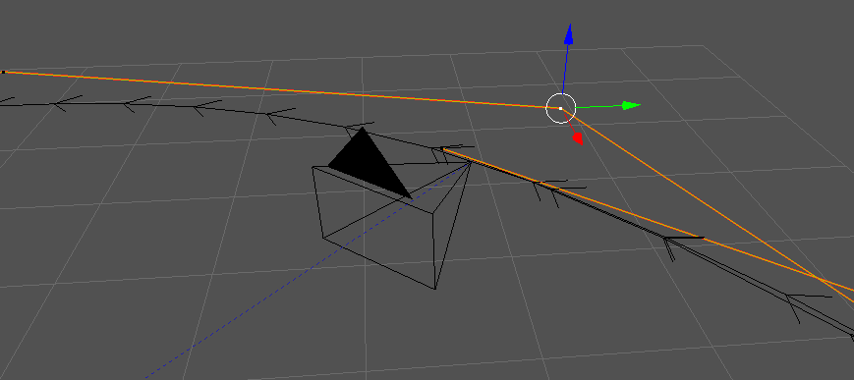
Camera movement
Path follow
Notes:
Problem camera angle

Slide 11
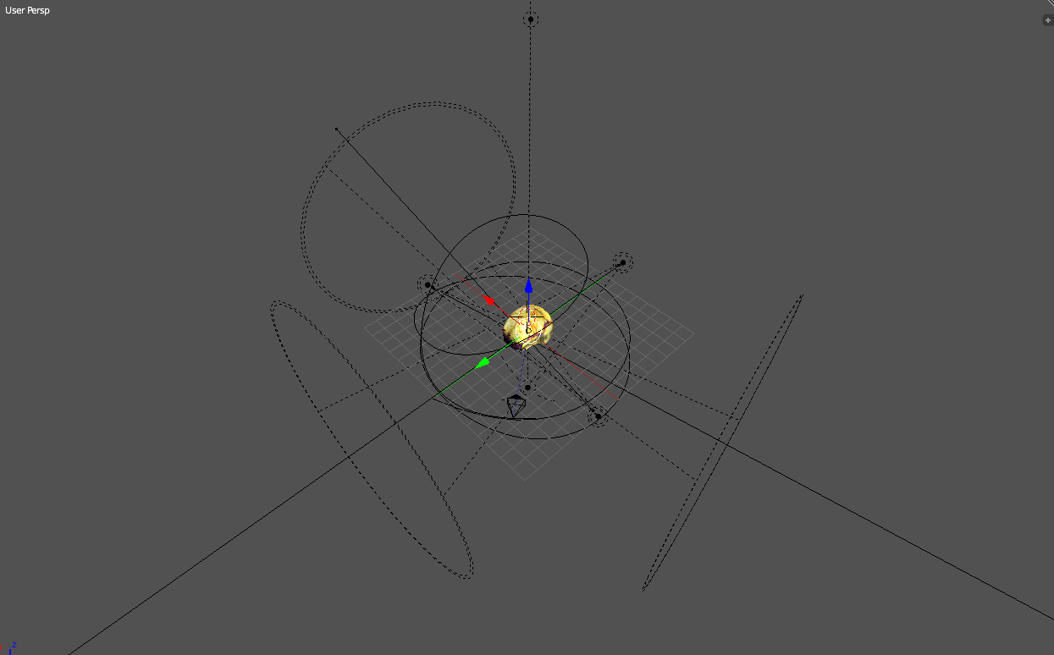
Final result

Slide 12
Danke :D

